Slide 1
Welcome Adiel
Muhammad Hamad

Slide 2
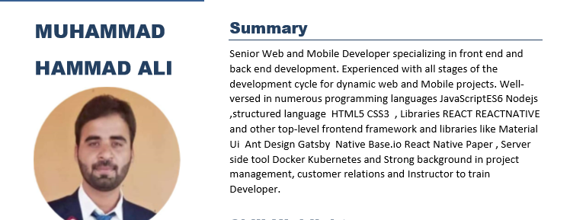

Slide 3


Slide 4
Web Mobile and Cloud Native Computing Module (1)
HTML 5

Slide 5
Web Mobile and Cloud Native Computing Module (1)
Css3
Bootstrap
Metalize CSS

Slide 6
Web Mobile and Cloud Native Computing Module (1)
java Script(Top trending Language)
GIT
FireBase

Slide 7

Web Mobile and Cloud Native Computing Module (1)
Firs Module

Slide 8
Make project and deploy it
Muhammad HAMAD

Slide 9
Web Mobile and Cloud Native Computing Module (2)
Advance concept of JS
React (Matrili Ui and Aunt )
Redux (Redux persist)

Slide 10
Web Mobile and Cloud Native Computing Module (2)
Node js
Heroku
pwa

Slide 11
Web Mobile and Cloud Native Computing Module (2)
2nd Module

Slide 12
Make project and deploy it
Muhammad HAMAD

Slide 13
Web Mobile and Cloud Native Computing Module (3)(Devops)
React native
Linux
Docker
Kubernaties

